Slide 1
Aneka
Cloud Application Platform

Slide 2
Aneka
Introduced by Manjrasoft Pty. Ltd.
for developing, deploying, and managing cloud applications.
consists of a scalable cloud middleware that can be deployed on top of heterogeneous computing resources.
It offers an extensible collection of services
coordinating the execution of applications,
helping administrators monitor the status of the cloud, and
providing integration with existing cloud technologies.
Aneka is a software platform for developing cloud computing applications.

Slide 3
Advantages of Aneka
extensible set of application programming interfaces (APIs) associated with different types of programming models such as
Task,
Thread, and
MapReduce
used for developing distributed applications, integrating new capabilities into the cloud, and supporting different types of cloud deployment models:
public,
private, and
hybrid

Slide 4
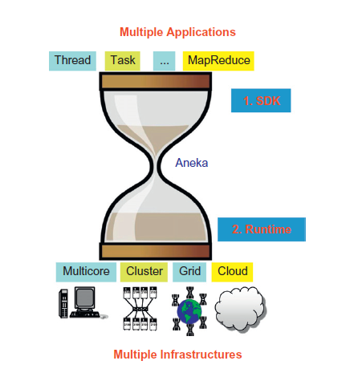
Aneka’s capabilities at a glance.

Slide 5
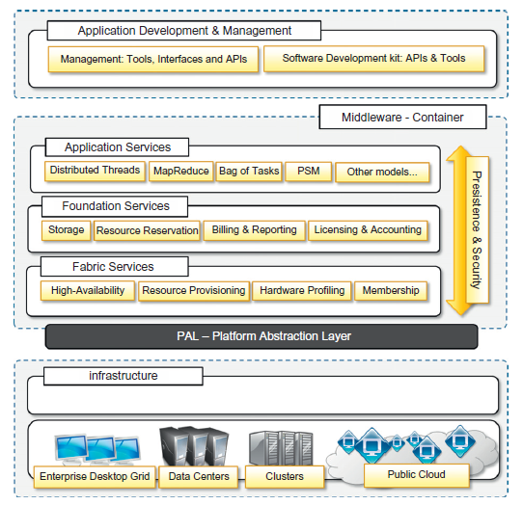
Aneka framework
Aneka implements a service-oriented architecture (SOA), and services are the fundamental components of an Aneka Cloud.
Services operate at container level and, except for the platform abstraction layer, they provide developers, users, and administrators with all features offered by the framework

Slide 6
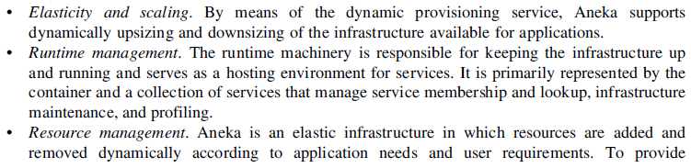

Aneka includes following services
Elasticity and scaling.

Slide 7
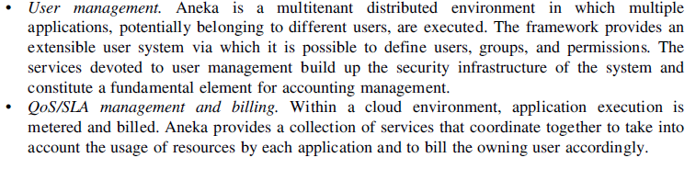

Slide 8
Aneka container can be classified into three major categories
Fabric Services
Foundation Services
Application Services

